Slide 1


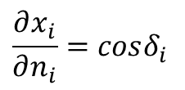











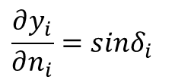



$$(x_{i},y_{i})$$
$$φ_{i}=\tan^{−1}{\frac{y_{i+1}−y_{i}}{x_{i+1}−x_{i}}}$$
$$\vec{U}$$
$$β_{i}=δ_{i}−α$$
$$δ_{i}$$
$$\vec{U}=Ucos\left(α\right)\hat{i}+Usin(α)\hat{j}$$
$$φ_{i}$$
$$α$$
$$δ_{i}=φ_{i}+{90}^{°}$$
$$β_{i}$$
$$(x_{i+1},y_{i+1})$$
$${\hat{n}}_{i}$$
$$∂x_{i}$$
$$\frac{∂x_{i}}{∂n_{i}}=cosδ_{i}$$
$$δ_{i}$$
$$∂y_{i}$$
$$\frac{∂y_{i}}{∂n_{i}}=sinδ_{i}$$
$$∂n_{i}$$

Slide 2
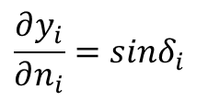

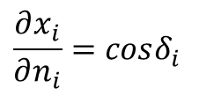


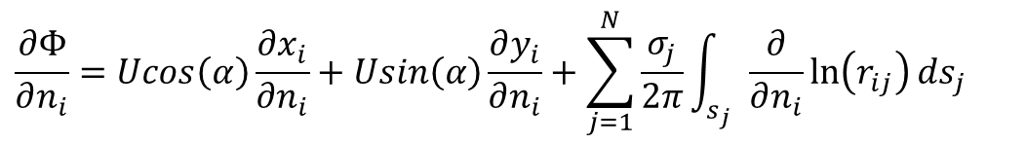

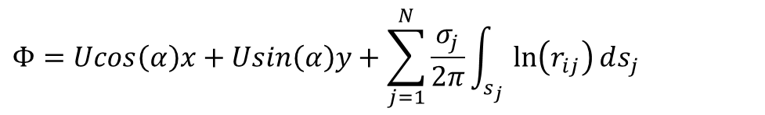

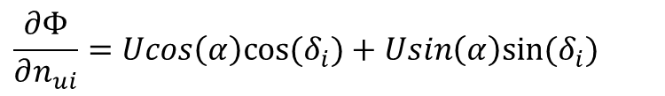
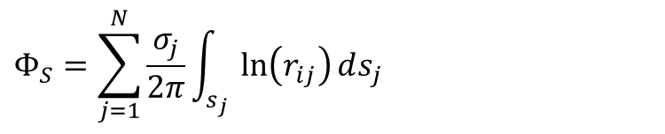
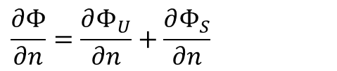

$$Φ=Φ_{U}+Φ_{S}$$
$$\frac{∂x_{i}}{∂n_{i}}=cosδ_{i}$$
$$Φ_{U}=Ucos\left(α\right)x+Usin\left(α\right)y$$
$$\frac{∂y_{i}}{∂n_{i}}=sinδ_{i}$$
$$Φ_{S}=\sum_{j=1}^{N}{\frac{σ_{j}}{2π}\int_{s_{j}}{\ln\left(r_{ij}\right)ds_{j}}}$$
$$\frac{∂Φ}{∂n}=\frac{∂Φ_{U}}{∂n}+\frac{∂Φ_{S}}{∂n}$$
$$Φ=Ucos\left(α\right)x+Usin\left(α\right)y+\sum_{j=1}^{N}{\frac{σ_{j}}{2π}\int_{s_{j}}{\ln\left(r_{ij}\right)ds_{j}}}$$
$$\frac{∂Φ}{∂n_{i}}=Ucos\left(α\right)\frac{∂x_{i}}{∂n_{i}}+Usin\left(α\right)\frac{∂y_{i}}{∂n_{i}}+\sum_{j=1}^{N}{\frac{σ_{j}}{2π}\int_{s_{j}}{\frac{∂}{∂n_{i}}\ln\left(r_{ij}\right)ds_{j}}}$$
$$\frac{∂Φ}{∂n_{ui}}=Ucos\left(α\right)cos⁡(δ_{i})+Usin\left(α\right)sin⁡(δ_{i})$$
$$δ_{i}=φ_{i}+{90}^{°}$$
$$=Ucos(α−δ_{i})$$
$$β_{i}=δ_{i}−α$$
$$=Ucos(δ_{i}−α)$$
$$=Ucos(β_{i})$$

Slide 3
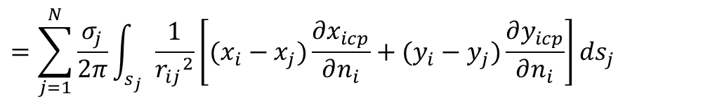
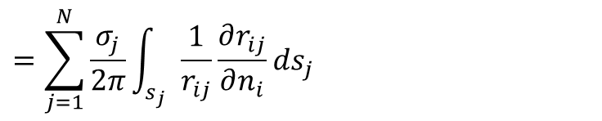
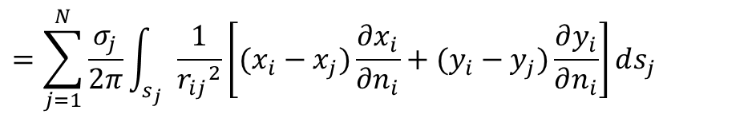
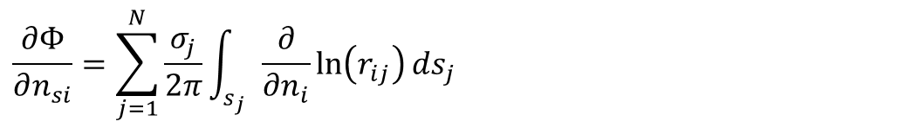
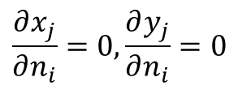
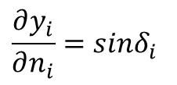
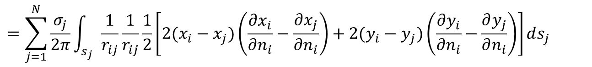
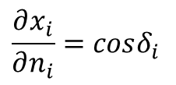
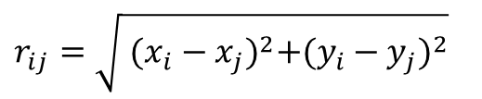
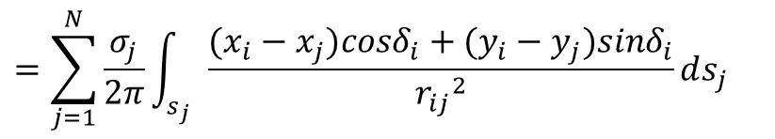
$$\frac{∂Φ}{∂n_{si}}=\sum_{j=1}^{N}{\frac{σ_{j}}{2π}\int_{s_{j}}{\frac{∂}{∂n_{i}}\ln\left(r_{ij}\right)ds_{j}}}$$
$$=\sum_{j=1}^{N}{\frac{σ_{j}}{2π}\int_{s_{j}}{\frac{1}{r_{ij}}\frac{∂r_{ij}}{∂n_{i}}ds_{j}}}$$
$$r_{ij}=\sqrt{{ (x_{i}−x_{j})}^{2}+{(y_{i}−y_{j})}^{2}}$$
$$=\sum_{j=1}^{N}{\frac{σ_{j}}{2π}\int_{s_{j}}{\frac{1}{r_{ij}}\frac{1}{r_{ij}}\frac{1}{2}\left[2(x_{i}−x_{j})\left(\frac{∂x_{i}}{∂n_{i}}−\frac{∂x_{j}}{∂n_{i}}\right)+2(y_{i}−y_{j})\left(\frac{∂y_{i}}{∂n_{i}}−\frac{∂y_{j}}{∂n_{i}}\right)\right]ds_{j}}}$$
$$=\sum_{j=1}^{N}{\frac{σ_{j}}{2π}\int_{s_{j}}{\frac{1}{{r_{ij}}^{2}}\left[(x_{i}−x_{j})\frac{∂x_{i}}{∂n_{i}}+(y_{i}−y_{j})\frac{∂y_{i}}{∂n_{i}}\right]ds_{j}}}$$
$$\frac{∂x_{j}}{∂n_{i}}=0,\frac{∂y_{j}}{∂n_{i}}=0$$
$$=\sum_{j=1}^{N}{\frac{σ_{j}}{2π}\int_{s_{j}}{\frac{1}{{r_{ij}}^{2}}\left[(x_{i}−x_{j})\frac{∂x_{icp}}{∂n_{i}}+(y_{i}−y_{j})\frac{∂y_{icp}}{∂n_{i}}\right]ds_{j}}}$$
$$=\sum_{j=1}^{N}{\frac{σ_{j}}{2π}\int_{s_{j}}{\frac{(x_{i}−x_{j})cosδ_{i}+(y_{i}−y_{j})sinδ_{i}}{{r_{ij}}^{2}}ds_{j}}}$$
$$\frac{∂x_{i}}{∂n_{i}}=cosδ_{i}$$
$$\frac{∂y_{i}}{∂n_{i}}=sinδ_{i}$$

Slide 4
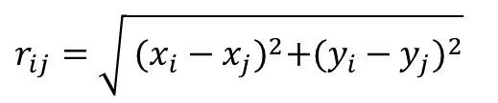
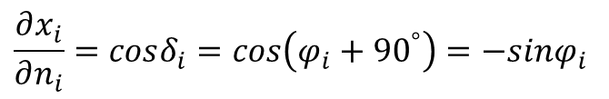
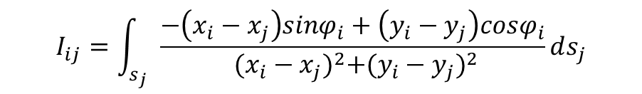
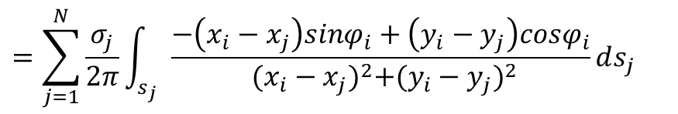
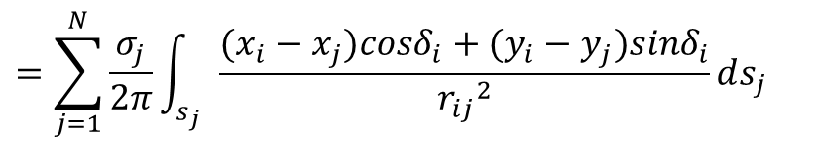

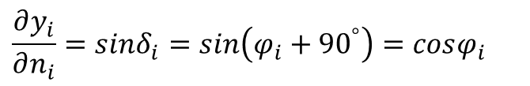
$$=\sum_{j=1}^{N}{\frac{σ_{j}}{2π}\int_{s_{j}}{\frac{(x_{i}−x_{j})cosδ_{i}+(y_{i}−y_{j})sinδ_{i}}{{r_{ij}}^{2}}ds_{j}}}$$
$$δ_{i}=φ_{i}+{90}^{°}$$
$$\frac{∂x_{i}}{∂n_{i}}=cosδ_{i}=cos\left(φ_{i}+{90}^{°}\right)=−sinφ_{i}$$
$$\frac{∂y_{i}}{∂n_{i}}=sinδ_{i}=sin\left(φ_{i}+{90}^{°}\right)=cosφ_{i}$$
$$r_{ij}=\sqrt{{ (x_{i}−x_{j})}^{2}+{(y_{i}−y_{j})}^{2}}$$
$$=\sum_{j=1}^{N}{\frac{σ_{j}}{2π}\int_{s_{j}}{\frac{−\left(x_{i}−x_{j}\right)sinφ_{i}+\left(y_{i}−y_{j}\right)cosφ_{i}}{{ (x_{i}−x_{j})}^{2}+{(y_{i}−y_{j})}^{2}}ds_{j}}}$$
$$I_{ij}=\int_{s_{j}}{\frac{−\left(x_{i}−x_{j}\right)sinφ_{i}+\left(y_{i}−y_{j}\right)cosφ_{i}}{{ (x_{i}−x_{j})}^{2}+{(y_{i}−y_{j})}^{2}}ds_{j}}$$

Slide 5








$$(X_{j+1},Y_{j+1})$$
$$(x_{i},y_{i})$$
$$(x_{j},y_{j})$$
$$s_{j}$$
$$φ_{j}$$
$$(X_{j},Y_{j})$$
$$x_{j}=X_{j}+s_{j}∙\cos{φ_{j}}$$
$$y_{j}=Y_{j}+s_{j}∙\sin{φ_{j}}$$

Slide 6
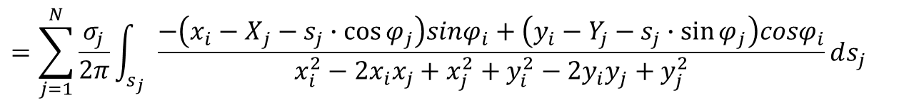
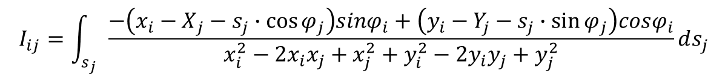
$$=\sum_{j=1}^{N}{\frac{σ_{j}}{2π}\int_{s_{j}}{\frac{−\left({x_{i}−X}_{j}−s_{j}∙\cos{φ_{j}}\right)sinφ_{i}+\left(y_{i}−Y_{j}−s_{j}∙\sin{φ_{j}}\right)cosφ_{i}}{x_{i}^{2}−2x_{i}x_{j}+x_{j}^{2}+y_{i}^{2}−2y_{i}y_{j}+y_{j}^{2}}ds_{j}}}$$
$$I_{ij}=\int_{s_{j}}{\frac{−\left({x_{i}−X}_{j}−s_{j}∙\cos{φ_{j}}\right)sinφ_{i}+\left(y_{i}−Y_{j}−s_{j}∙\sin{φ_{j}}\right)cosφ_{i}}{x_{i}^{2}−2x_{i}x_{j}+x_{j}^{2}+y_{i}^{2}−2y_{i}y_{j}+y_{j}^{2}}ds_{j}}$$
Numerator
$$−\left({x_{i}−X}_{j}−s_{j}∙\cos{φ_{j}}\right)sinφ_{i}+\left(y_{i}−Y_{j}−s_{j}∙\sin{φ_{j}}\right)cosφ_{i}$$
$$=−x_{i}sinφ_{i}+X_{j}sinφ_{i}+s_{j}∙\cos{φ_{j}}sinφ_{i}+y_{i}cosφ_{i}−Y_{j}cosφ_{i}−s_{j}∙sinφ_{j}cosφ_{i}$$
$$=s_{j}∙\cos{φ_{j}}sinφ_{i}−s_{j}∙sinφ_{j}cosφ_{i}−x_{i}sinφ_{i}+X_{j}sinφ_{i}+y_{i}cosφ_{i}−Y_{j}cosφ_{i}$$
$$=s_{j}\left(\cos{φ_{j}}sinφ_{i}−sinφ_{j}cosφ_{i}\right)+\left(X_{j}−x_{i}\right)sinφ_{i}−(Y_{j}−y_{i})cosφ_{i}$$
$$=s_{j}sin(φ_{i}−φ_{j})+\left(X_{j}−x_{i}\right)sinφ_{i}−(Y_{j}−y_{i})cosφ_{i}$$

Slide 7
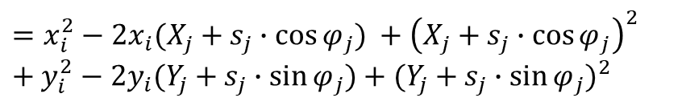
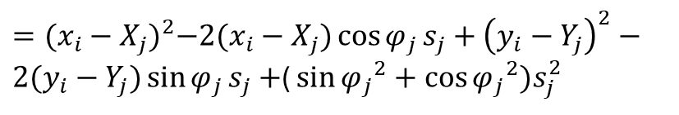
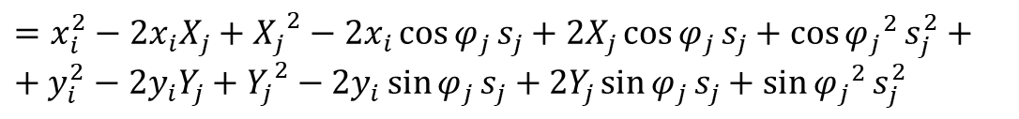
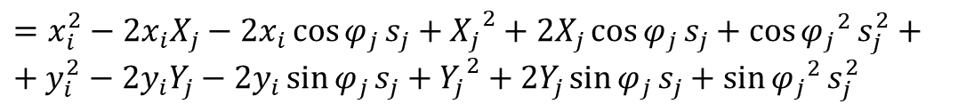
Denominator
$$x_{i}^{2}−2x_{i}x_{j}+x_{j}^{2}+y_{i}^{2}−2y_{i}y_{j}+y_{j}^{2}$$
$$=x_{i}^{2}−2x_{i}(X_{j}+s_{j}∙\cos{φ_{j}}) +{\left(X_{j}+s_{j}∙\cos{φ_{j}}\right)}^{2}+y_{i}^{2}−2y_{i}(Y_{j}+s_{j}∙\sin{φ_{j}})+{(Y_{j}+s_{j}∙\sin{φ_{j}})}^{2}$$
$=x_{i}^{2}−2x_{i}X_{j}−2x_{i}\cos{φ_{j}}s_{j}+{X_{j}}^{2}+2X_{j}\cos{φ_{j}}s_{j}+{\cos{φ_{j}}}^{2}s_{j}^{2}++y_{i}^{2}−2y_{i}Y_{j}−2y_{i}\sin{φ_{j}}s_{j}+{Y_{j}}^{2}+2Y_{j}\sin{φ_{j}}s_{j}+$ ${\sin{φ_{j}}}^{2}s_{j}^{2}$
$=x_{i}^{2}−2x_{i}X_{j}+{X_{j}}^{2}−2x_{i}\cos{φ_{j}}s_{j}+2X_{j}\cos{φ_{j}}s_{j}+{\cos{φ_{j}}}^{2}s_{j}^{2}++y_{i}^{2}−2y_{i}Y_{j}+{Y_{j}}^{2}−2y_{i}\sin{φ_{j}}s_{j}+2Y_{j}\sin{φ_{j}}s_{j}+$ ${\sin{φ_{j}}}^{2}s_{j}^{2}$
$={(x_{i}−X_{j})}^{2}−2(x_{i}−X_{j})\cos{φ_{j}}s_{j}+{\left(y_{i}−Y_{j}\right)}^{2}−2(y_{i}−Y_{j})\sin{φ_{j}}s_{j}+$( ${\sin{φ_{j}}}^{2}+{\cos{φ_{j}}}^{2})s_{j}^{2}$
$$={(x_{i}−X_{j})}^{2}+{\left(y_{i}−Y_{j}\right)}^{2}−2[\left(x_{i}−X_{j}\right)\cos{φ_{j}}+(y_{i}−Y_{j})\sin{φ_{j}}] s_{j}+s_{j}^{2}$$
$$=s_{j}^{2}−2\left[\left(x_{i}−X_{j}\right)\cos{φ_{j}}+\left(y_{i}−Y_{j}\right)\sin{φ_{j}}\right]s_{j}+{\left(x_{i}−X_{j}\right)}^{2}+{\left(y_{i}−Y_{j}\right)}^{2}$$

Slide 8
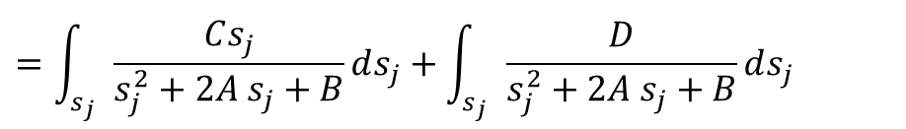
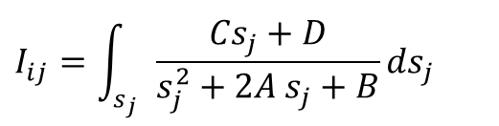
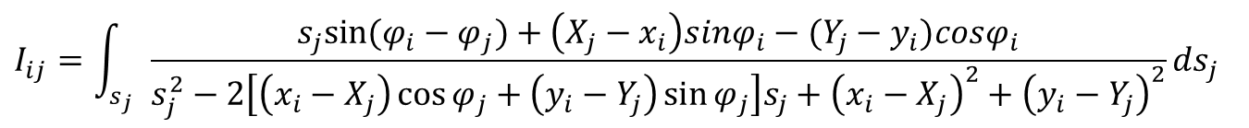


$$I_{ij}=\int_{s_{j}}{\frac{s_{j}sin(φ_{i}−φ_{j})+\left(X_{j}−x_{i}\right)sinφ_{i}−(Y_{j}−y_{i})cosφ_{i}}{s_{j}^{2}−2\left[\left(x_{i}−X_{j}\right)\cos{φ_{j}}+\left(y_{i}−Y_{j}\right)\sin{φ_{j}}\right]s_{j}+{\left(x_{i}−X_{j}\right)}^{2}+{\left(y_{i}−Y_{j}\right)}^{2}}ds_{j}}$$
$$A=−\left[\left(x_{i}−X_{j}\right)\cos{φ_{j}}+(y_{i}−Y_{j})\sin{φ_{j}}\right]$$
$$B={ \left(x_{i}−X_{j}\right)}^{2}+{ \left(y_{i}−Y_{j}\right)}^{2}$$
$$C=sin⁡(φ_{i}−φ_{j})$$
$D=$ $\left(X_{j}−x_{i}\right)sinφ_{i}−(Y_{j}−y_{i})cosφ_{i}$
$$I_{ij}=\int_{s_{j}}{\frac{Cs_{j}+D}{s_{j}^{2}+2A s_{j}+B}ds_{j}}$$
$$=\int_{s_{j}}{\frac{Cs_{j}}{s_{j}^{2}+2A s_{j}+B}ds_{j}}+\int_{s_{j}}{\frac{D}{s_{j}^{2}+2A s_{j}+B}ds_{j}}$$
$$s_{j}^{2}+2A s_{j}+B=s_{j}^{2}+2A s_{j}+A^{2}−A^{2}+B$$
$$={(s_{j}+A)}^{2}+B−A^{2}$$

Slide 9

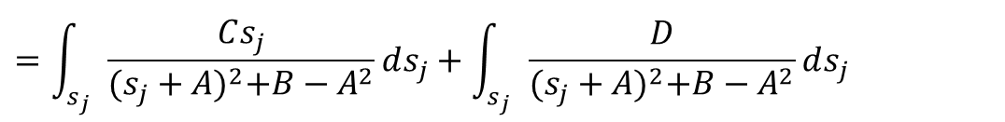

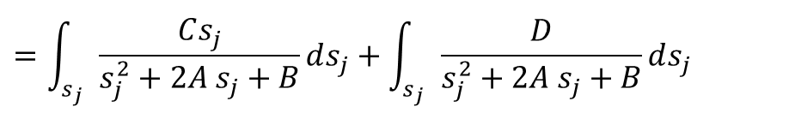
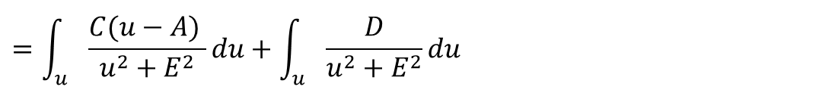

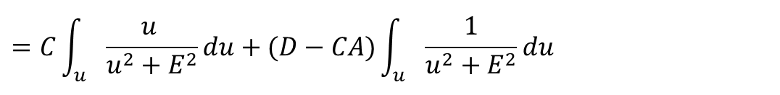

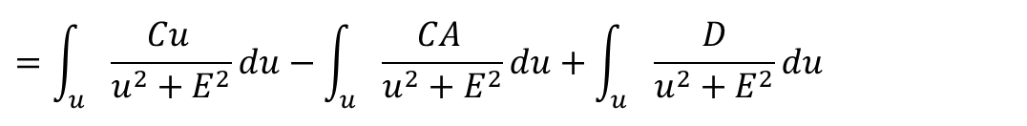
$$=\int_{s_{j}}{\frac{Cs_{j}}{s_{j}^{2}+2A s_{j}+B}ds_{j}}+\int_{s_{j}}{\frac{D}{s_{j}^{2}+2A s_{j}+B}ds_{j}}$$
$$=\int_{s_{j}}{\frac{Cs_{j}}{{(s_{j}+A)}^{2}+B−A^{2}}ds_{j}}+\int_{s_{j}}{\frac{D}{{(s_{j}+A)}^{2}+B−A^{2}}ds_{j}}$$
$$u=s_{j}+A$$
$$s_{j}=u−A$$
$$E^{2}=B−A^{2}$$
$$du=ds_{j}$$
$$=\int_{u_{}}{\frac{C(u−A) }{u^{2}+E^{2}}du}+\int_{u_{}}{\frac{D}{u^{2}+E^{2}}du}$$
$$=\int_{u_{}}{\frac{Cu }{u^{2}+E^{2}}du}−\int_{u_{}}{\frac{CA }{u^{2}+E^{2}}du}+\int_{u_{}}{\frac{D}{u^{2}+E^{2}}du}$$
$$=C\int_{u_{}}{\frac{u }{u^{2}+E^{2}}du}+(D−CA)\int_{u_{}}{\frac{1}{u^{2}+E^{2}}du}$$

Slide 10

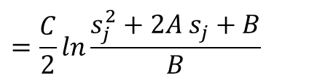

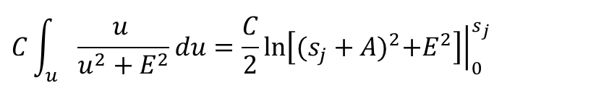

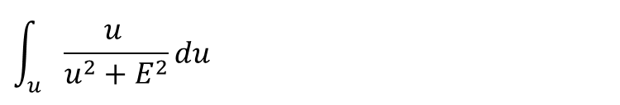
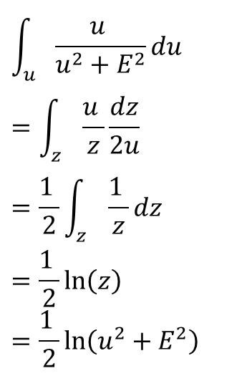
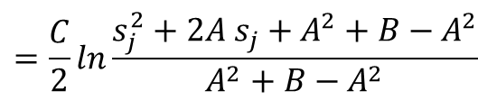
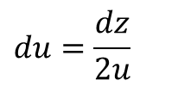
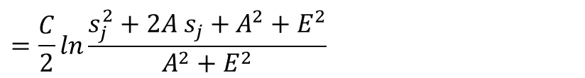
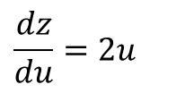
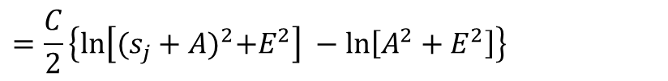
$$\int_{u_{}}{\frac{u }{u^{2}+E^{2}}du}$$
$$\int_{u_{}}{\frac{u }{u^{2}+E^{2}}du}=\int_{z_{}}{\frac{u }{z}\frac{dz}{2u}}=\frac{1 }{2}\int_{z_{}}{\frac{1 }{z}dz}=\frac{1 }{2}\ln\left(z\right)=\frac{1 }{2}\ln\left(u^{2}+E^{2}\right)$$
$$z=u^{2}+E^{2}$$
$$\frac{dz}{du}=2u$$
$$du=\frac{dz}{2u}$$
$$C\int_{u_{}}{\frac{u }{u^{2}+E^{2}}du}=\frac{C}{2}{\left.ln\left[{(s_{j}+A)}^{2}+E^{2}\right]⁡\right|}_{0}^{s_{j}}$$
$$u=s_{j}+A$$
$$=\frac{C}{2}\left\{ln\left[{(s_{j}+A)}^{2}+E^{2}\right] −ln\left[A^{2}+E^{2}\right]\right\}$$
$$=\frac{C}{2}ln\frac{s_{j}^{2}+2A s_{j}+A^{2}+E^{2}}{A^{2}+E^{2}}$$
$$E^{2}=B−A^{2}$$
$$=\frac{C}{2}ln\frac{s_{j}^{2}+2A s_{j}+A^{2}+B−A^{2}}{A^{2}+B−A^{2}}$$
$$=\frac{C}{2}ln\frac{s_{j}^{2}+2A s_{j}+B}{B}$$

Slide 11
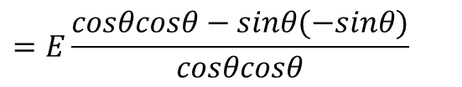
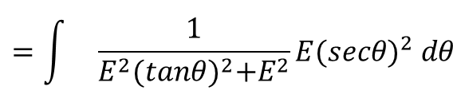
















$$\int_{u_{}}{\frac{1}{u^{2}+E^{2}}du}$$
$$\int_{u_{}}{\frac{1}{u^{2}+E^{2}}du}$$
$$u=Etanθ$$
$$=\int_{{}_{}}{\frac{1}{E^{2}{(tanθ)}^{2}+E^{2}}E{(secθ)}^{2} dθ}$$
$$u^{2}=E^{2}{(tanθ)}^{2}$$
$${(tanθ)}^{2}={(secθ)}^{2}−1$$
$$=\int_{{}_{}}{\frac{E}{E^{2}}\frac{1}{{(secθ)}^{2}−1+1}{(secθ)}^{2} dθ}$$
$u^{2}+E^{2}=E^{2}[{1+(secθ)}^{2}$]
$$\frac{du}{dθ}=E\frac{d}{dθ}\frac{sinθ}{cosθ}$$
$$=\int_{{}_{}}{\frac{1}{E}\frac{{(secθ)}^{2}}{{(secθ)}^{2}}dθ}$$
$$=E\frac{cosθcosθ−sinθ(−sinθ)}{cosθcosθ}$$
$$=\frac{1}{E}\int_{{}_{}}{dθ}$$
$$=E\frac{1}{{(cosθ)}^{2}}$$
$$=\frac{1}{E}θ$$
$$=E{(secθ)}^{2}$$
$du=E{(secθ)}^{2}$ $dθ$
$$u=Etanθ →tan θ=\frac{u}{E} → θ=\tan^{−1}{\frac{u}{E}}$$
$$=\frac{1}{E}\tan^{−1}{\frac{u}{E}}$$
$$u=s_{j}+A$$

Slide 12







$$\int_{u_{}}{\frac{1}{u^{2}+E^{2}}du}=\frac{1}{E}\tan^{−1}{\frac{u}{E}}$$
$$=\frac{1}{E}{\left.\tan^{−1}{\frac{s_{j}+A}{E}}\right|}_{0}^{s_{j}}$$
$$=\frac{1}{E}\left(\tan^{−1}{\frac{s_{j}+A}{E}}−\tan^{−1}{\frac{A}{E}}\right)$$
$$I_{ij}=\frac{C}{2}ln\frac{s_{j}^{2}+2A s_{j}+B}{B}+\frac{D−CA}{E}\left(\tan^{−1}{\frac{s_{j}+A}{E}}−\tan^{−1}{\frac{A}{E}}\right)$$
$$\frac{∂Φ}{∂n_{si}}=\sum_{j=1}^{N}{\frac{σ_{j}}{π}I_{ij}}$$
$$I_{ij}=\int_{s_{j}}{\frac{\left(x_{i}−x_{j}\right)sinφ_{i}+\left(y_{i}−y_{j}\right)cosφ_{i}}{{ (x_{j}−x_{i})}^{2}+{(y_{j}−y_{i})}^{2}}ds_{j}}$$
$$\frac{∂Φ}{∂n_{i}}=\sum_{j=1}^{N}{\frac{σ_{j}}{2π}\left[\frac{C}{2}ln\frac{s_{j}^{2}+2A s_{j}+B}{B}+\frac{D−CA}{E}\left(\tan^{−1}{\frac{s_{j}+A}{E}}−\tan^{−1}{\frac{A}{E}}\right)\right]}$$

Slide 13





$$\frac{∂Φ}{∂n}=\frac{∂Φ_{U}}{∂n}+\frac{∂Φ_{S}}{∂n}$$
$$=Ucos\left(β_{i}\right)+\sum_{j=1}^{N}{\frac{σ_{j}}{2π}\left[\frac{C}{2}ln\frac{s_{j}^{2}+2A s_{j}+B}{B}+\frac{D−CA}{E}\left(\tan^{−1}{\frac{s_{j}+A}{E}}−\tan^{−1}{\frac{A}{E}}\right)\right]}$$
$=0$
$$\sum_{j=1}^{N}{\frac{σ_{j}}{2π}\left[\frac{C}{2}ln\frac{s_{j}^{2}+2A s_{j}+B}{B}+\frac{D−CA}{E}\left(\tan^{−1}{\frac{s_{j}+A}{E}}−\tan^{−1}{\frac{A}{E}}\right)\right]}=−Ucos\left(β_{i}\right)$$
$$A=−\left[\left(x_{i}−X_{j}\right)\cos{φ_{j}}+(y_{i}−Y_{j})\sin{φ_{j}}\right]$$
$$B={ \left(x_{i}−X_{j}\right)}^{2}+{ \left(y_{i}−Y_{j}\right)}^{2}$$
$$C=sin⁡(φ_{i}−φ_{j})$$
$D=$ $\left(X_{j}−x_{i}\right)sinφ_{i}−(Y_{j}−y_{i})cosφ_{i}$
$$E=\sqrt{B−A^{2}}$$

Slide 14
CP

Slide 15

















$$V_{t,i}={\frac{∂φ_{i}}{∂t_{i}}=U}_{∞}\cos{α∙\frac{∂x_{i}}{∂t_{i}}+}U_{∞}\sin{α∙\frac{∂y_{i}}{∂t_{i}}+}\sum_{j=1}^{N}{\frac{σ_{j}}{2π}\int_{j}{\frac{∂}{∂t_{i}}ln{(r}_{ij})ds_{j}}}$$
$$∂t_{i}$$
$$\frac{∂x_{i}}{∂t_{i}}=cosφ_{i}$$
$$φ_{i}$$
$$∂y_{i}$$
$$∂x_{i}$$
$$\frac{∂y_{i}}{∂t_{i}}=sinφ_{i}$$
$$U_{∞}\cos{α∙\frac{∂x_{i}}{∂t_{i}}+}U_{∞}\sin{α∙\frac{∂y_{i}}{∂t_{i}}}=U_{∞}(\cos{α}∙cosφ_{i}+sinα∙sinφ_{i})$$
$$=U_{∞}cos⁡(α−φ_{i})$$
$$δ_{i}=φ_{i}+{90}^{°}$$
$$=U_{∞}cos⁡(φ_{i}−α)$$
$$φ_{i}=δ_{i}−{90}^{°}$$
$$=U_{∞}cos⁡(δ_{i}−{90}^{°}−α)$$
$$β_{i}=δ_{i}−α$$
$$=U_{∞}cos⁡(β_{i}+α−{90}^{°}−α)$$
$$δ_{i}=β_{i}+α$$
$$=U_{∞}cos⁡(β_{i}−{90}^{°})$$
$$=U_{∞}sin⁡(β_{i})$$

Slide 16










$$V_{t,i}=\frac{∂φ_{i}}{∂t_{i}}=sinβ_{i}+\sum_{j=1}^{N}{\frac{σ_{j}}{2π}\int_{j}{\frac{∂}{∂t_{i}}ln{(r}_{ij})ds_{j}}}$$
$$J_{ij}=\int_{j}{\frac{∂}{∂t_{i}}ln{(r}_{ij})ds_{j}}$$
$$r_{ij}=\sqrt{{\left(x_{i}−x_{j}\right)}^{2}+{\left(y_{i}−y_{j}\right)}^{2}}$$
$$=\int_{j}{\frac{2\left(x_{i}−x_{j}\right)\frac{∂x_{i}}{∂t_{i}}+2\left(y_{i}−y_{j}\right)\frac{∂y_{i}}{∂t_{i}}}{2{\left[{\left(x_{i}−x_{j}\right)}^{2}+{\left(y_{i}−y_{j}\right)}^{2}\right]}^{\frac{1}{2}}∙{\left[{\left(x_{i}−x_{j}\right)}^{2}+{\left(y_{i}−y_{j}\right)}^{2}\right]}^{\frac{1}{2}}}ds_{j}}$$
$$\frac{∂x_{i}}{∂t_{i}}=cosφ_{i}$$
$$\frac{∂y_{i}}{∂t_{i}}=sinφ_{i}$$
$$=\int_{j}{\frac{\left(x_{i}−x_{j}\right)\cos{φ_{i}}+\left(y_{i}−y_{j}\right)\sin{φ_{i}}}{{\left(x_{i}−x_{j}\right)}^{2}+{\left(y_{i}−y_{j}\right)}^{2}}ds_{j}}$$
$x_{j}=X_{j}+s_{j}∙\cos{φ_{j}}$ $y_{j}=Y_{j}+s_{j}∙\sin{φ_{j}}$
$$=\int_{j}{\frac{\left(x_{i}−X_{j}−s_{j}∙\cos{φ_{j}}\right)\cos{φ_{i}}+\left(y_{i}−Y_{j}−s_{j}∙\sin{φ_{j}}\right)\sin{φ_{i}} }{{\left(x_{i}−x_{j}\right)}^{2}+{\left(y_{i}−y_{j}\right)}^{2}}ds_{j}}$$
$$=\int_{j}{\frac{−\left(\cos{φ_{j}\cos{φ_{i}}}+\sin{φ_{j}}\sin{φ_{i}}\right)s_{j}+\left(x_{i}−X_{j}\right)\cos{φ_{i}}+(y_{i}−Y_{j})\sin{φ_{i}}}{{\left(x_{i}−x_{j}\right)}^{2}+{\left(y_{i}−y_{j}\right)}^{2}}ds_{j}}$$

Slide 17




$$=\int_{j}{\frac{−\left(\cos{φ_{j}\cos{φ_{i}}}+\sin{φ_{j}}\sin{φ_{i}}\right)s_{j}+\left(x_{i}−X_{j}\right)\cos{φ_{i}}+(y_{i}−Y_{j})\sin{φ_{i}}}{s_{j}^{2}+2[\left(X_{j}−x_{i}\right)\cos{φ_{j}}+(Y_{j}−y_{i})\sin{φ_{j}}]+{(x_{i}−X_{j})}^{2}{\left(y_{i}−Y_{j}\right)}^{2}}ds_{j}}$$
$$=\int_{j}{\frac{Cs_{j}+D}{s_{j}^{2}+2As_{j}+B}ds_{j}}$$
$$A=−\left[\left(x_{i}−X_{j}\right)\cos{φ_{j}}+(y_{i}−Y_{j})\sin{φ_{j}}\right]$$
$$B={(x_{i}−X_{j})}^{2}{\left(y_{i}−Y_{j}\right)}^{2}$$
$$C=−cos(φ_{j}−φ_{i})$$
$$D=\left(x_{i}−X_{j}\right)\cos{φ_{i}}+(y_{i}−Y_{j})\sin{φ_{i}}$$
$$J_{ij}=\frac{C}{2}\ln{\frac{s_{j}^{2}+2As_{j}+B}{B}}+ \frac{D−AC}{E}\left[\arctan{\frac{s_{j}+A}{E}}−\arctan{\frac{A}{E}}\right]$$
$$V_{t,i}=Usinβ_{i}+\sum_{j=1}^{N}{\frac{σ_{j}}{2π}\left\{\frac{C}{2}\ln{\frac{s_{j}^{2}+2As_{j}+B}{B}}+ \frac{D−AC}{E}\left[\arctan{\frac{s_{j}+A}{E}}−\arctan{\frac{A}{E}}\right]\right\}}$$

Slide 19
Velocity at Field Points

Slide 20









$$Φ=Φ_{U}+Φ_{S}$$
$$\frac{∂x_{i}}{∂t_{i}}=cosδ_{i}$$
$$Φ_{U}=Ucos\left(α\right)x+Usin\left(α\right)y$$
$$\frac{∂y_{i}}{∂t_{i}}=sinδ_{i}$$
$$Φ_{S}=\sum_{j=1}^{N}{\frac{σ_{j}}{2π}\int_{s_{j}}{\ln\left(r_{ij}\right)ds_{j}}}$$
$$\frac{∂Φ}{∂x}=\frac{∂Φ_{U}}{∂x}+\frac{∂Φ_{S}}{∂x}$$
$$\frac{∂Φ}{∂y}=\frac{∂Φ_{U}}{∂y}+\frac{∂Φ_{S}}{∂y}$$
$$Φ_{i}=Ucos\left(α\right)x+Usin\left(α\right)y+\sum_{j=1}^{N}{\frac{σ_{j}}{2π}\int_{s_{j}}{\ln\left(r_{pj}\right)ds_{j}}}$$
$$V_{x,p}=\frac{∂Φ}{∂x_{p}}=Ucos\left(α\right)\frac{∂x}{∂x_{p}}+Usin\left(α\right)\frac{∂y}{∂x_{p}}+\sum_{j=1}^{N}{\frac{σ_{j}}{2π}\int_{s_{j}}{\frac{∂}{∂x_{p}}\ln\left(r_{pj}\right)ds_{j}}}$$
$$V_{y,p}=\frac{∂Φ}{∂y_{p}}=Ucos\left(α\right)\frac{∂x}{∂y_{p}}+Usin\left(α\right)\frac{∂y}{∂y_{p}}+\sum_{j=1}^{N}{\frac{σ_{j}}{2π}\int_{s_{j}}{\frac{∂}{∂y_{p}}\ln\left(r_{pj}\right)ds_{j}}}$$

Slide 21






$$V_{x,p}=Ucos\left(α\right)+\sum_{j=1}^{N}{\frac{σ_{j}}{2π}\int_{s_{j}}{\frac{∂}{∂x_{p}}\ln\left(r_{pj}\right)ds_{j}}}$$
$$\int_{s_{j}}{\frac{∂}{∂x_{p}}\ln\left(r_{pj}\right)ds_{j}}$$
$$=\int_{s_{j}}^{ }{\frac{1}{r_{pj}} \frac{∂}{∂x_{p}}r_{pj}ds_{j}}$$
$$=\int_{s_{j}}^{ }{\frac{1}{r_{pj}}\frac{∂}{∂x_{p}} {\left[{\left(x_{p}−x_{j}\right)}^{2}+{\left(y_{p}−y_{j}\right)}^{2}\right]}^{\frac{1}{2}}}ds_{j}$$
$$=\int_{s_{j}}^{ }{\frac{1}{r_{pj}}\frac{1}{r_{pj}}∙\frac{1}{2}\left[2\left(x_{p}−x_{j}\right)\frac{∂}{∂x_{p}}\left(x_{p}−x_{j}\right)+2\left(y_{p}−y_{j}\right)\frac{∂}{∂x_{p}} \left(y_{p}−y_{j}\right)\right]}ds_{j}$$
$$=\int_{s_{j}}^{ }{\frac{\left(x_{p}−x_{j}\right)}{{\left(x_{p}−x_{j}\right)}^{2}+{\left(y_{p}−y_{j}\right)}^{2}}}ds_{j}$$

Slide 22








$$x_{j}=X_{j}+s_{j}∙\cos{φ_{j}}$$
$$y_{j}=Y_{j}+s_{j}∙\sin{φ_{j}}$$
$$=\int_{s_{j}}^{ }{\frac{\left(x_{p}− X_{j}−s_{j}∙\cos{φ_{j}}\right)}{{\left(x_{p}−x_{j}\right)}^{2}+{\left(y_{p}−y_{j}\right)}^{2}}}ds_{j}$$
$$=\int_{s_{j}}^{ }{\frac{−s_{j}∙\cos{φ_{j}}+x_{p}− X_{j}}{x_{p}^{2}−2x_{p}x_{j}+x_{j}^{2}+y_{p}^{2}−2y_{p}y_{j}+y_{j}^{2}}}ds_{j}$$
$$x_{p}^{2}−2x_{p}x_{j}+x_{j}^{2}+y_{p}^{2}−2y_{p}y_{j}+y_{j}^{2}$$
$$=x_{p}^{2}−2x_{p}\left[X_{j}+s_{j}∙\cos{φ_{j}}\right]+{\left[X_{j}+s_{j}∙\cos{φ_{j}}\right]}^{2}+ y_{p}^{2}−2y_{p}\left[Y_{j}+s_{j}∙\sin{φ_{j}}\right]+{\left[Y_{j}+s_{j}∙\sin{φ_{j}}\right]}^{2}$$
$$=x_{p}^{2}−2x_{p}X_{j}−2x_{p}\cos{φ_{j}}s_{j}+X_{j}^{2}+2X_{j}\cos{φ_{j}}s_{j}+{\left(s_{j}∙\cos{φ_{j}}\right)}^{2}+y_{p}^{2}−2y_{p}Y_{j}−2y_{p}\sin{φ_{j}}s_{j}+Y_{j}^{2}+2Y_{j}\sin{φ_{j}}s_{j}+{(s_{j}∙\sin{φ_{j}})}^{2}$$
$$=x_{p}^{2}−2x_{p}X_{j}+X_{j}^{2}−2(x_{p}−X_{j})\cos{φ_{j}}s_{j}+{\left(s_{j}∙\cos{φ_{j}}\right)}^{2}+y_{p}^{2}−2y_{p}Y_{j}+Y_{j}^{2}−2(y_{p}−Y_{j})\sin{φ_{j}}s_{j}+{(s_{j}∙\sin{φ_{j}})}^{2}$$
$$={(x_{p}−X_{j})}^{2}+{(y_{p}−Y_{j})}^{2}−2x_{p}\cos{φ_{j}}s_{j}+2X_{j}\cos{φ_{j}}s_{j}−2y_{p}\sin{φ_{j}}s_{j}+2Y_{j}\sin{φ_{j}}s_{j}+({\cos{φ_{j}}}^{2}+{\sin{φ_{j}}}^{2}){s_{j}}^{2}$$
$$={s_{j}}^{2}−2[\left(x_{p}−X_{j}\right)\cos{φ_{j}}+\left(y_{p}−Y_{j}\right)\sin{φ_{j}}]s_{j}+{(x_{p}−X_{j})}^{2}+{(y_{p}−Y_{j})}^{2}$$

Slide 23



$$=\int_{s_{j}}^{ }{\frac{−{\cos{φ_{j}}s}_{j}+x_{p}− X_{j}}{{s_{j}}^{2}−2[\left(x_{p}−X_{j}\right)\cos{φ_{j}}+\left(y_{p}−Y_{j}\right)\sin{φ_{j}}]s_{j}+{(x_{p}−X_{j})}^{2}+{(y_{p}−Y_{j})}^{2}}}ds_{j}$$
$$=\int_{s_{j}}^{ }{\frac{Cs_{j}+D}{{s_{j}}^{2}+2As_{j}+B}}ds_{j}$$
$$A=−[\left(x_{p}−X_{j}\right)\cos{φ_{j}}+\left(y_{p}−Y_{j}\right)\sin{φ_{j}}]$$
$$B={(x_{p}−X_{j})}^{2}+{(y_{p}−Y_{j})}^{2}$$
$$C=−\cos{φ_{j}}$$
$$D=x_{p}− X_{j}$$
$$V_{x,p}=Ucos\left(α\right)+\sum_{j=1}^{N}{\frac{σ_{j}}{2π}\left[\frac{C}{2}ln\frac{s_{j}^{2}+2A s_{j}+B}{B}+\frac{D−CA}{E}\left(\tan^{−1}{\frac{s_{j}+A}{E}}−\tan^{−1}{\frac{A}{E}}\right)\right] }$$

Slide 24






$$V_{y,p}=Usin\left(α\right)+\sum_{j=1}^{N}{\frac{σ_{j}}{2π}\int_{s_{j}}{\frac{∂}{∂y_{p}}\ln\left(r_{pj}\right)ds_{j}}}$$
$$\int_{s_{j}}{\frac{∂}{∂y_{p}}\ln\left(r_{pj}\right)ds_{j}}$$
$$=\int_{s_{j}}^{ }{\frac{1}{r_{pj}} \frac{∂}{∂y_{p}}r_{pj}ds_{j}}$$
$$=\int_{s_{j}}^{ }{\frac{1}{r_{pj}}\frac{∂}{∂y_{p}} {\left[{\left(x_{p}−x_{j}\right)}^{2}+{\left(y_{p}−y_{j}\right)}^{2}\right]}^{\frac{1}{2}}}ds_{j}$$
$$=\int_{s_{j}}^{ }{\frac{1}{r_{pj}}\frac{1}{r_{pj}}∙\frac{1}{2}\left[2\left(x_{p}−x_{j}\right)\frac{∂}{∂y_{p}}\left(x_{p}−x_{j}\right)+2\left(y_{p}−y_{j}\right)\frac{∂}{∂y_{p}} \left(y_{p}−y_{j}\right)\right]}ds_{j}$$
$$=\int_{s_{j}}^{ }{\frac{\left(y_{p}−y_{j}\right)}{{\left(x_{p}−x_{j}\right)}^{2}+{\left(y_{p}−y_{j}\right)}^{2}}}ds_{j}$$

Slide 25


$$x_{j}=X_{j}+s_{j}∙\cos{φ_{j}}$$
$$y_{j}=Y_{j}+s_{j}∙\sin{φ_{j}}$$
$$=\int_{s_{j}}^{ }{\frac{\left(y_{p}−y_{j}\right)}{{\left(x_{p}−x_{j}\right)}^{2}+{\left(y_{p}−y_{j}\right)}^{2}}}ds_{j}=\int_{s_{j}}^{ }{\frac{\left(y_{p}− Y_{j}−s_{j}∙\sin{φ_{j}}\right)}{{\left(x_{p}−x_{j}\right)}^{2}+{\left(y_{p}−y_{j}\right)}^{2}}}ds_{j}$$
$$=\int_{s_{j}}^{ }{\frac{−s_{j}∙\sin{φ_{j}}+y_{p}− Y_{j}}{x_{p}^{2}−2x_{p}x_{j}+x_{j}^{2}+y_{p}^{2}−2y_{p}y_{j}+y_{j}^{2}}}ds_{j}$$
$$x_{p}^{2}−2x_{p}x_{j}+x_{j}^{2}+y_{p}^{2}−2y_{p}y_{j}+y_{j}^{2}$$
$$=x_{p}^{2}−2x_{p}\left[X_{j}+s_{j}∙\cos{φ_{j}}\right]+{\left[X_{j}+s_{j}∙\cos{φ_{j}}\right]}^{2}+ y_{p}^{2}−2y_{p}\left[Y_{j}+s_{j}∙\sin{φ_{j}}\right]+{\left[Y_{j}+s_{j}∙\sin{φ_{j}}\right]}^{2}$$
$$=x_{p}^{2}−2x_{p}X_{j}−2x_{p}\cos{φ_{j}}s_{j}+X_{j}^{2}+2X_{j}\cos{φ_{j}}s_{j}+{\left(s_{j}∙\cos{φ_{j}}\right)}^{2}+y_{p}^{2}−2y_{p}Y_{j}−2y_{p}\sin{φ_{j}}s_{j}+Y_{j}^{2}+2Y_{j}\sin{φ_{j}}s_{j}+{(s_{j}∙\sin{φ_{j}})}^{2}$$
$$=x_{p}^{2}−2x_{p}X_{j}+X_{j}^{2}−2(x_{p}−X_{j})\cos{φ_{j}}s_{j}+{\left(s_{j}∙\cos{φ_{j}}\right)}^{2}+y_{p}^{2}−2y_{p}Y_{j}+Y_{j}^{2}−2(y_{p}−Y_{j})\sin{φ_{j}}s_{j}+{(s_{j}∙\sin{φ_{j}})}^{2}$$
$$={(x_{p}−X_{j})}^{2}+{(y_{p}−Y_{j})}^{2}−2x_{p}\cos{φ_{j}}s_{j}+2X_{j}\cos{φ_{j}}s_{j}−2y_{p}\sin{φ_{j}}s_{j}+2Y_{j}\sin{φ_{j}}s_{j}+({\cos{φ_{j}}}^{2}+{\sin{φ_{j}}}^{2}){s_{j}}^{2}$$
$$={s_{j}}^{2}−2[\left(x_{p}−X_{j}\right)\cos{φ_{j}}+\left(y_{p}−Y_{j}\right)\sin{φ_{j}}]s_{j}+{(x_{p}−X_{j})}^{2}+{(y_{p}−Y_{j})}^{2}$$

Slide 26


$$=\int_{s_{j}}^{ }{\frac{−s_{j}∙\sin{φ_{j}}+y_{p}− Y_{j}}{{s_{j}}^{2}−2[\left(x_{p}−X_{j}\right)\cos{φ_{j}}+\left(y_{p}−Y_{j}\right)\sin{φ_{j}}]s_{j}+{(x_{p}−X_{j})}^{2}+{(y_{p}−Y_{j})}^{2}}}ds_{j}$$
$$=\int_{s_{j}}^{ }{\frac{Cs_{j}+D}{{s_{j}}^{2}+2As_{j}+B}}ds_{j}$$
$$A=−[\left(x_{p}−X_{j}\right)\cos{φ_{j}}+\left(y_{p}−Y_{j}\right)\sin{φ_{j}}]$$
$$B={(x_{p}−X_{j})}^{2}+{(y_{p}−Y_{j})}^{2}$$
$$C=−\sin{φ_{j}}$$
$$D=y_{p}− Y_{j}$$
$$V_{y,p}=Usin\left(α\right)+\sum_{j=1}^{N}{\frac{σ_{j}}{2π}\left[\frac{C}{2}ln\frac{s_{j}^{2}+2A s_{j}+B}{B}+\frac{D−CA}{E}\left(\tan^{−1}{\frac{s_{j}+A}{E}}−\tan^{−1}{\frac{A}{E}}\right)\right] }$$

